Slide 1
COMP 3014 Industry Engagement
Notes:
- Anyone here not expexting 3014

Slide 2
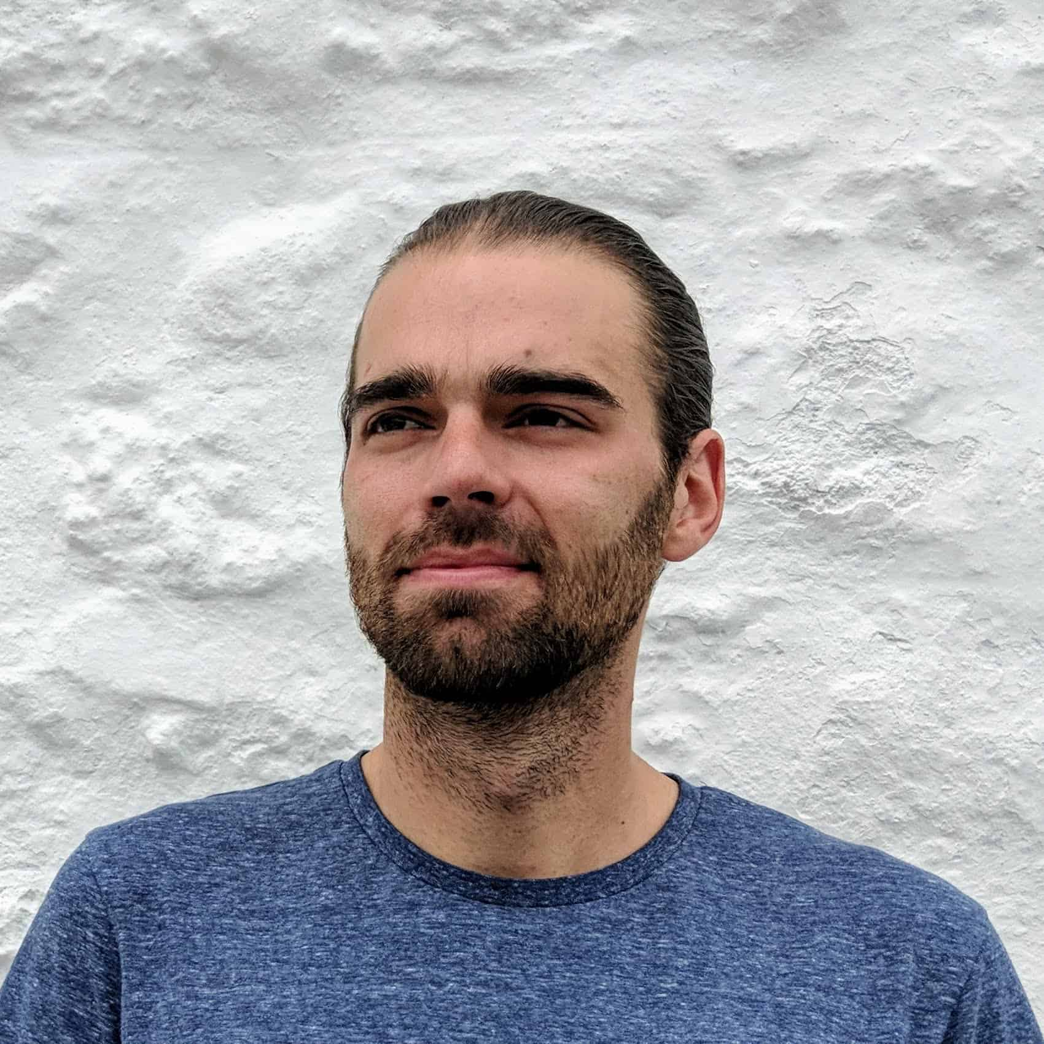
Hello!
I am Tony Edwards
I am here to guide you through your module journey
You can contact me via Teams or anthony.edwards@plymouth.ac.uk

Slide 3
COMP 3014 Industry Engagement

Slide 4
Today’s session’s
Introduce the module
Walk through key parts of the first assignment
Setup some core tools for the weeks ahead
Start your personal post mortem
Notes:
- Using the language of games, no requirement

Slide 5
This Module
1
You get to choose your own adventure. . .
Notes:
- The most flexible module at the university
- there is one over arching goal. . .

Slide 6
Engage with an Industry
Notes:
Take something you’ve made and engage with industry
Formed a company, launched game
Built a portfolio & got feedback
Went networking and met their future employers

Slide 7


Take something you’ve made
And get feedback from industry
Notes:
Could be your 3013 game
Could be something for a pervious module
Could be your personal brand and portfolio In order to do that. . .

Slide 8
Come up with a plan
. . . and execute it
Notes:
I’d expect you to have seen most of the processes we use
Gannt - Not looking for perfect, technical example
2 weeks of a post mortum
2 weeks of planning
Execute for the rest of the module

Slide 9
This was my favorite module of the year. It helped support my other assignments and had a positive impact on my job prospects after graduating . said no one ever
Notes:
Highest rating withing comp-sci
Kept them in uni. . . Could see the point
Filled in skill gaps (video editing)
Paradim world expert (pre-release vids)

Slide 10
As part of this module, students often:
Develop their portfolio
Package university work together into a coherent portfolio whilst establishing a personal brand to help with career goals.
Learn new skills
By identifying skill gaps, supported self-study could let you focus on acquiring new skills and learning new tools to support personal and professional growth.
Connect with industry
Use online platforms and in person events to connect with industry figures.
Narrow in on a career path
Develop ideas and goals for post graduation and take steps to make them a reality.

Slide 11
You decide. . .

Slide 12
Two Assignments
Strategy Plan
A single document with supporting evidence outlining your strategy for engaging with your chosen industry.
Journey Pitch and Supporting Evidence
Deliver a 7ish minute pitch about your journey executing your strategy plan.
This module is filled with living documents You’ll iterate a core set of documents and add new ones as the module progresses. As you make new learnings along your journey, these core documents should be updated often.
Notes:
- Build these up over time.
Not something you do at the end
Living documents adapt and change

Slide 13
Two Submissions
3rd March
Submission of your strategy plan for the remainder of the module.
6th May Submission of the evidence documenting the implementation of your plan.
Notes:
If you are putting your plan together at this point, I can make predictions about your grade
I urge you to get this done in the first 4 weeks

Slide 14


And a post a week
You’re expected to provide a weekly forum or blog post covering the work completed that week.
Notes:
Worth 10%. Could be worth more.
Engage with each others posts, give feedback, steal ideas.

Slide 15
Individually graded
Notes:
- Even if working as a team. . .

Slide 16
Self led
Notes:
- You get to decide what you do

Slide 17
Collaborative
Notes:
- We’ll share research
We’ll share
Not a zero sum game

Slide 18
Code-lite
Notes:
- No expectation to write software
- Create headspace for your other code heavy modules

Slide 19
Session times
Notes:
- What does your timetable for a Monday look like?

Slide 20
Hard to cheat
Notes:
As long as you are not submitting the same work, we’re good.
I encourage you to use any AI tools that you think will help

Slide 21
Three Stages
Port Mortem
Analyse your professional skills, personal skills, project portfolio for strengths and weaknesses.
- 2 Weeks
Strategise
Create a strategy for engaging with industry over the remainder of the module, and document it.
- 2 Weeks
Execute
Put your plan into action.
- 11 Weeks
Notes:
Post mortum
Take an honest look at your uni time & skillset
Strategise
Use your post mortum as the basis of your plan.
What are you going to do. When are you going to do it

Slide 22
Four assessed learning outcomes
Critically evaluate and apply strategies for product placement, marketing and social media.
Promote project work effectively to the target market.
Participate in appropriate sector events: hackathons, game jams, developer conferences.
Apply due diligence in the production, documentation and release of products.
Notes:
- These apply to both yourself and any projects

Slide 23
The Journey. . .
Pitch example 1
https://dle.plymouth.ac.uk/mod/resource/view.php?id=1487179
Available via the DLE page
Pitch example 2
https://dle.plymouth.ac.uk/mod/resource/view.php?id=1487181

Slide 24
What questions do you have?
?

Slide 25
The Setup
2
Let’s get three key tools in place
Notes:
- We’ll cover the second assignment in due course.

Slide 26
Setup OneDrive
On your personal university OneDrive
Create a folder for the module

Slide 27
Join Teams
Open teams and find the module group you’ve been added to.
Add a smiley to the smiley thread.

Slide 28

Register
It’s time to register for class. ZI-OB-DP
“Students register their attendance” https://creator.nightcafe.studio/creation/SKkLdAX75aId4Y31P6OK

Slide 29
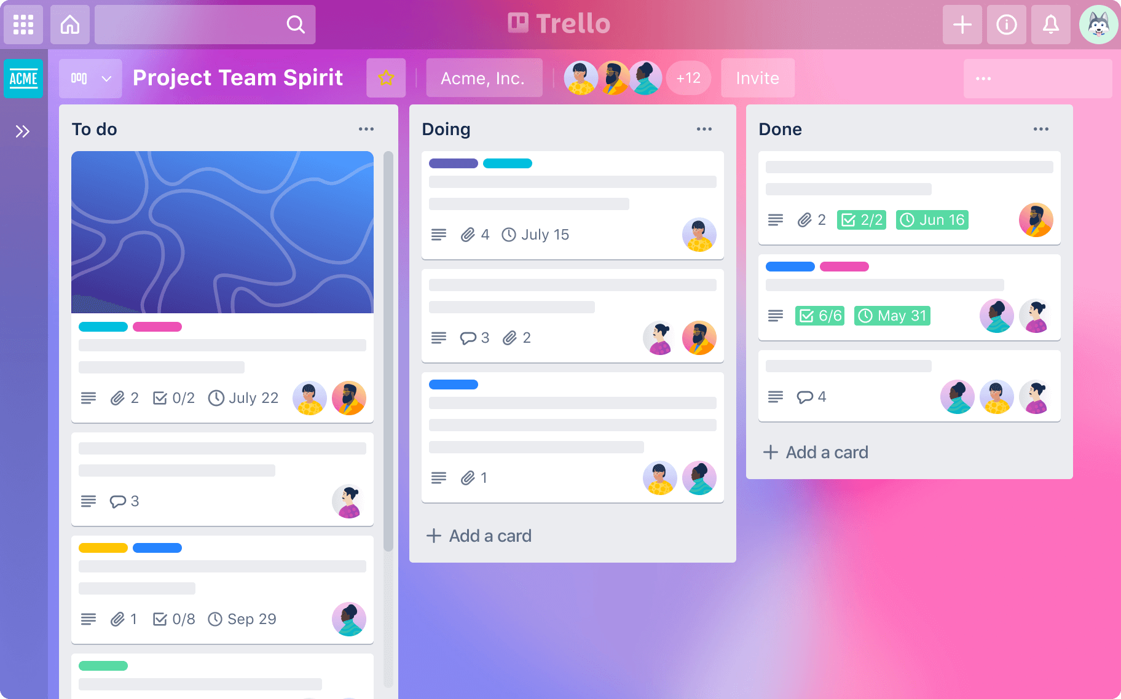
Trello
Manage your module.
Notes:
- Quite prescriptive in the first few weeks
- You might use something different

Slide 30
Setup Trello
Login to Trello
Create a new personal board called ‘3014’ or something similar
Create the following columns and cards. . .

Slide 31
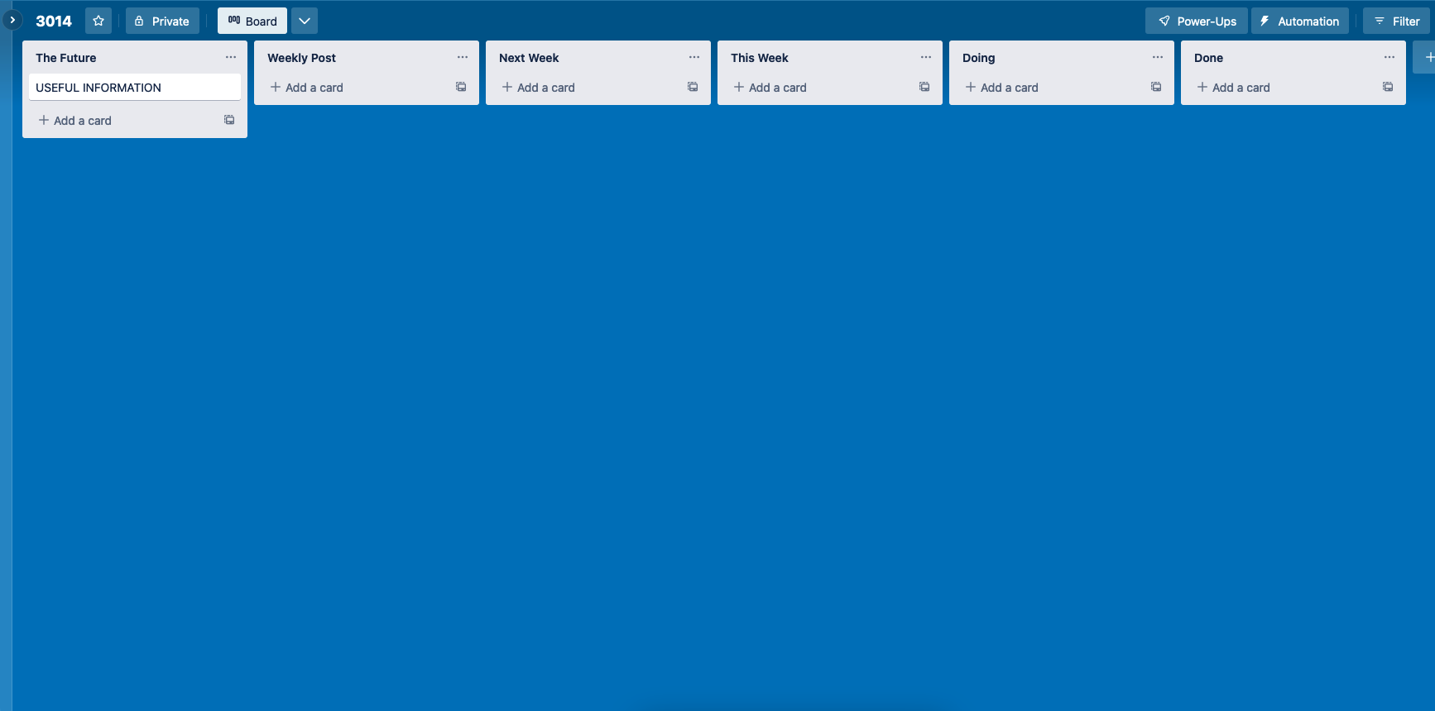
Starter Board

Slide 32
Follow along. . .
https://trello.com/b/PCBgLPH6/3014-24-25
Notes:
https://trello.com/b/PCBgLPH6/3014-24-25

Slide 33
Break?

Slide 34
The First Assignment
3
A post mortem and strategy plan
Notes:
- We’ll cover the second assignment in due course.

Slide 35
Overview
Complete a “Strategy Plan” template based on the activities described below
To successfully promote yourself and engage with an industry, you will need to analyse your current skillset and portfolio in relation to an industry’s needs.
You will also have to identify current and future opportunities to promote yourself and interact with relevant parties.
This information will inform your overall goal and initial strategy plan.

Slide 36
One Submission
Feedback (03/03)
A single document with supporting evidence outlining your strategy for engaging with your chosen industry.
Submission (03/03)
An iterated and refined version of your feedback version.

Slide 37
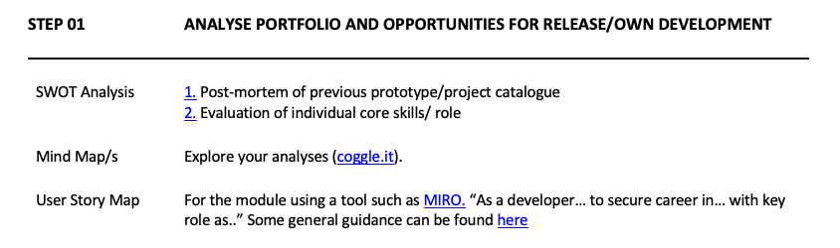

Slide 38
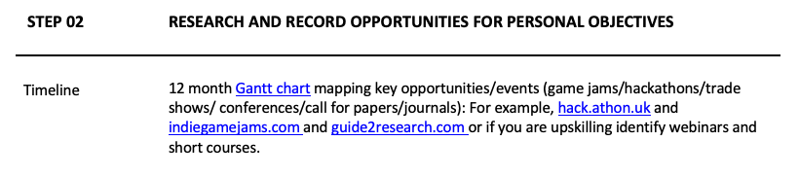

Slide 39
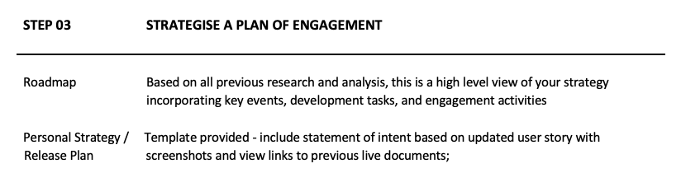

Slide 40
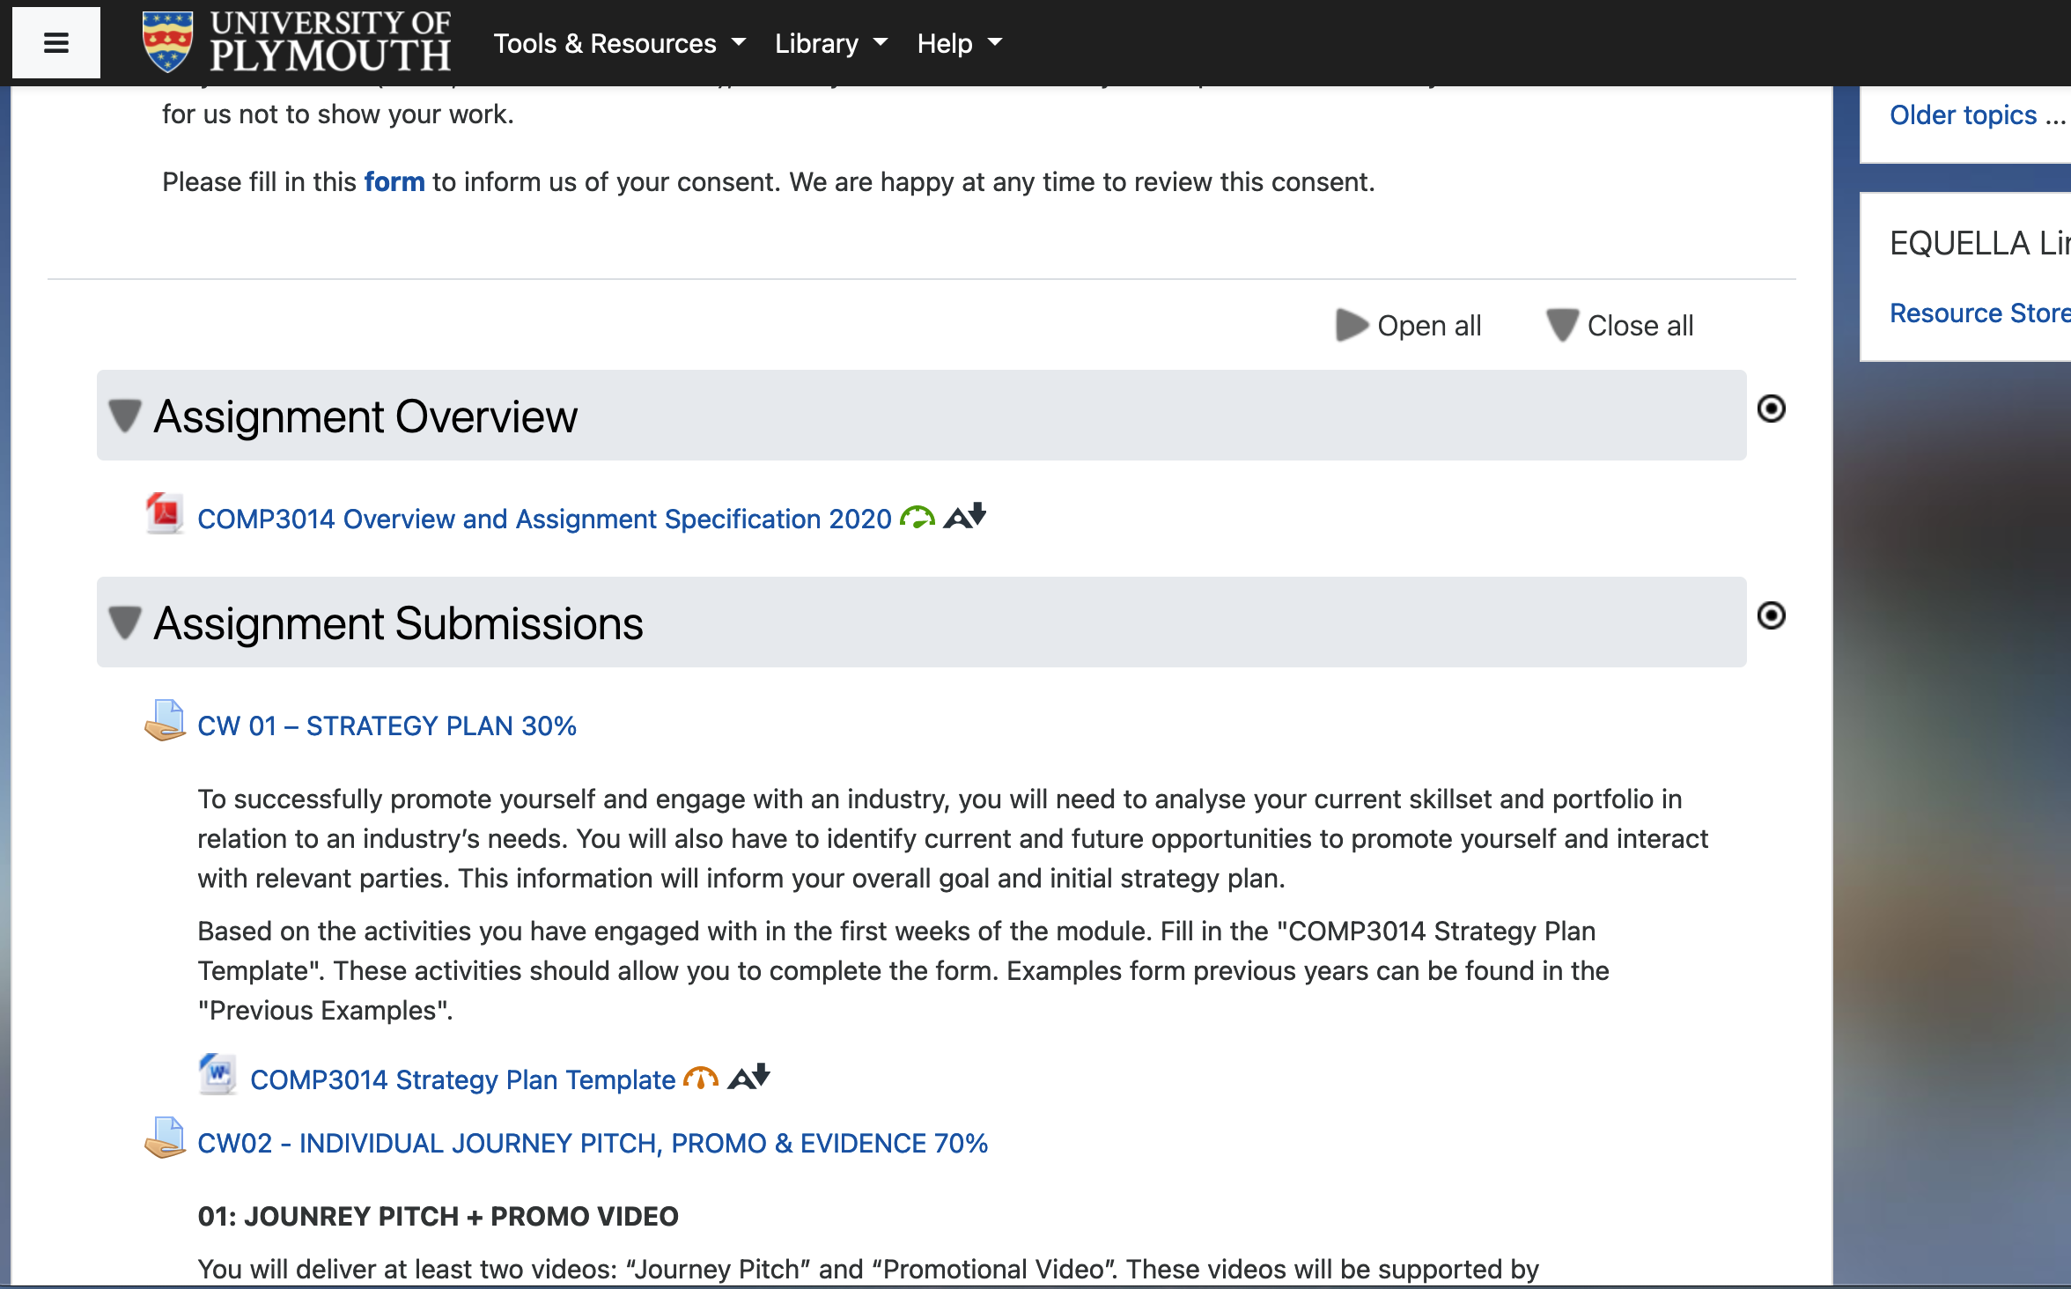
Store the spec
Find the assignment spec on the DLE:
Add it to your OneDrive folder.
Read the marking rubric for assignment 1 (5 mins)

Slide 41
What questions do you have?
?

Slide 42
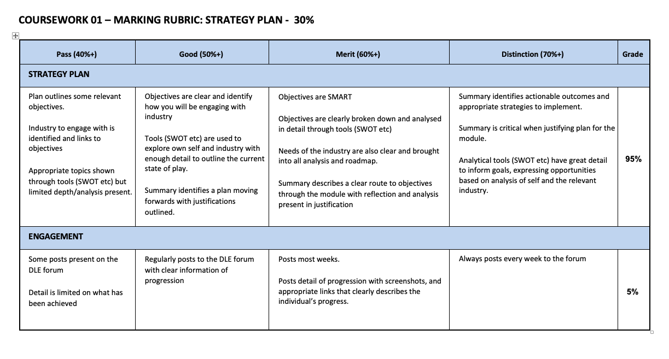
90%
10%
Notes:
Engagement will drive the strategy plan.
There is more value to it than 10%. It’ll improve the 90%

Slide 43
Follow along. . .
https://trello.com/b/hbU9rqx6/3014
Notes:
- Add submission dates

Slide 44
The next few weeks
Mind Maps / SWOT
Analyse your current skillset and portfolio in relation to an industry’s needs plus your future career and life goals.
Build your Roadmap
Start collating your industry research and goals, moving towards an actionable plan.
Week 2
Week 4
Week 1
Week 3
User Story Mapping
Use Agile tools to develop a personal persona and set of user stories around your ideas.
Build your Strategy Plan
Collate your learnings and research into a plan of action, ready for feedback.
Notes:
Aim to have your plan complete by the end of week 4

Slide 45
Self reflection. . .

Slide 46
Which should lead to. . .
Notes:
Some sense of direction that you’re going.
Ultimatley, you’ll set some goals
Android Developer
Video Game Developer
YouTuber

Slide 47
SMART Objectives
A form of objec­tive set­ting which allows individuals (and businesses) to cre­ate, track and accom­plish, short-and-long-term goals in a strategic and measurable way.

Slide 48

Which should lead to. . .

Slide 49
SMART Goal Example:
Specific: I’m going to write a 60,000-word sci-fi novel.
Measurable: I will finish writing 60,000 words in 6 months.
Achievable: I will write 2,500 words per week.
Relevant: I’ve always dreamed of becoming a professional writer.
Time-bound: I will start writing tomorrow on January 1st, and finish June 30th.
Which turns into. . .
I’m going to write a 60,000-word novel in 6 months, finishing on June 30th. I will do this by writing 2,500 words per week.
Notes:
Know what, why, how you’ll know your succeeding

Slide 50

Half of all employ­ees don’t know what is expect­ed of them at work. When this is the case, employ­ees get frus­trat­ed, con­fused and dis­en­gaged.
Source | Image
Notes:
Land a £2 million client
Became disengaged because I didn’t know if I was succeeding or not

Slide 51
Activity
You have 60 seconds to improve your seating arrangement.

Slide 52

Activity
You have 60 seconds to improve your seating arrangement.

Slide 53
Did you. . .
meet the objective?
have a clear understanding of the objective?
What would have improved the objective?

Slide 54
You have 60 seconds to improve the seating arrangements
Chairs should be in rows
Chairs should all face one of the screens.
There should be space between the front row and screen for someone to stand.
You will be watching a 9 minute long video.

Slide 55
Activity
You have 60 seconds to improve your seating arrangement.

Slide 56
Today is the day
There’s one thing students mention during reflection activities orders of magnitude more than anything else.
Notes:
Time management
Comes out of having goals

Slide 57
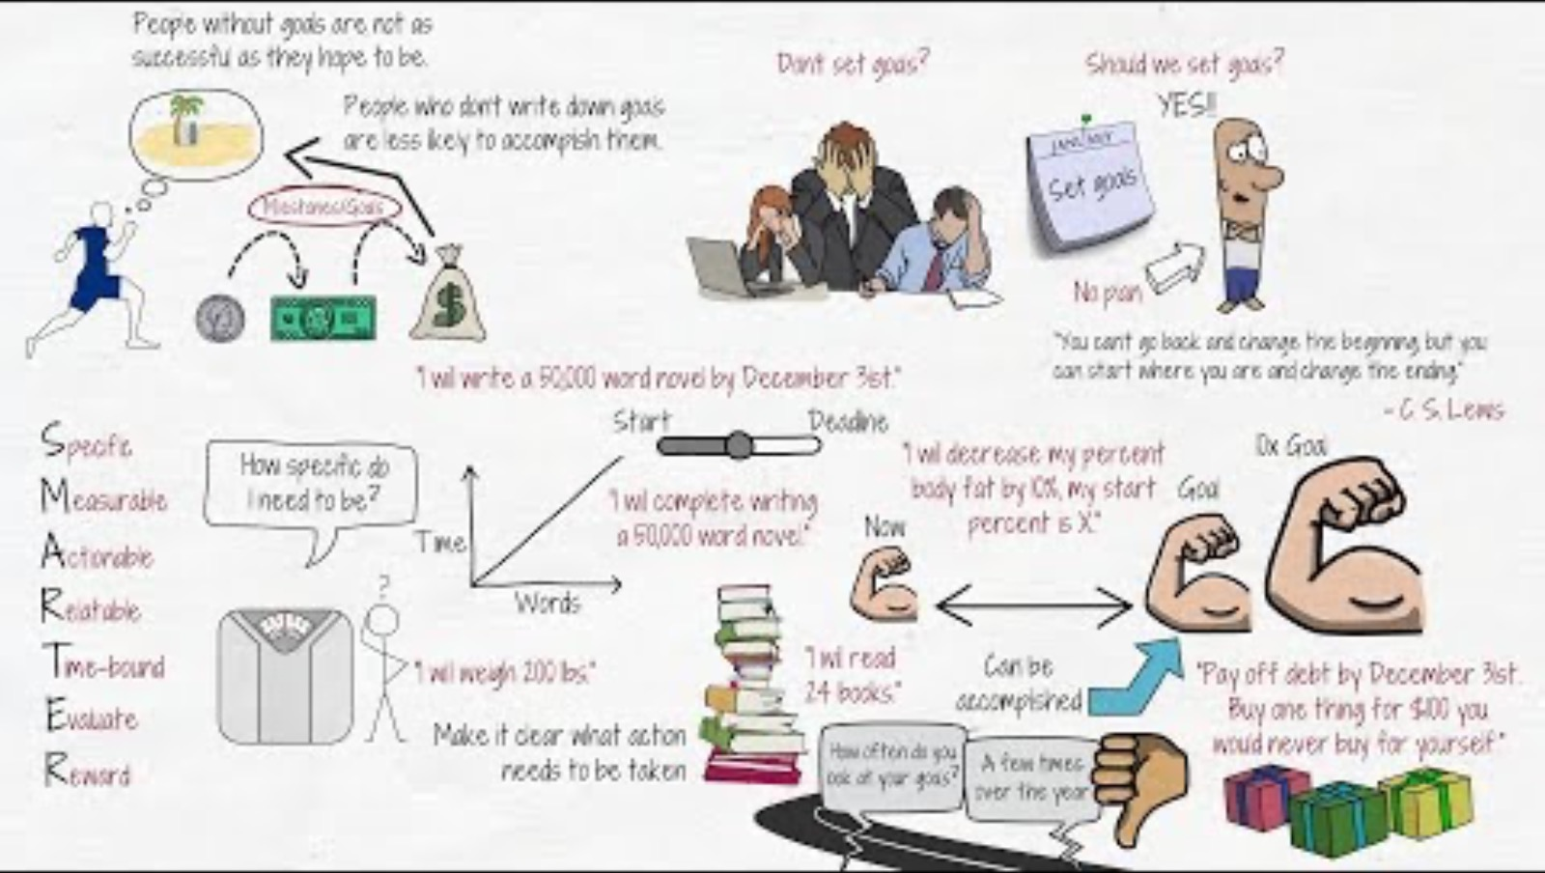

Slide 58
Lunch?

Slide 59
COMP 3014 Industry Engagement

Slide 60
Register
It’s time to register for class. VQ-VW-TV
“Students register their attendance” https://creator.nightcafe.studio/creation/SKkLdAX75aId4Y31P6OK

Slide 61
What questions do you have?
?

Slide 62
View a plan
Find the example strategy plans on the DLE
Take a look at a few
Anything jump out?

Slide 63
Save the template
Find the strategy plan template on the DLE
Add it to you OneDrive folder.
Add a link to the Assignment 1 card on Trello.

Slide 64
This Afternoon, we’ll start your . . .
Personal Mind Map
Start mapping your thoughts to form the foundation of your module plan.
Personal SWOT analysis
Reflect on yourself to highlight potential areas of focus for the module.
These are two of the living documents mentioned earlier.

Slide 65
Gather your thoughts

Slide 66
These are processes that. . .
aid in problem solving.
help you move towards a goal.
you might do multiple times.
are flexible.

Slide 67
Retrospective
3
Reflect on your time at university
Notes:
- You’re going to be entering the real world.

Slide 68
What is a retrospective?
A retrospective is an opportunity to learn and improve. It is time set aside to reflect on past events and behaviours.
The Agile methodology typically suggests asking four questions. . .
Source

Slide 69
Retrospective
What went well?
What didn’t go well?
What will you do the same?
What will you do different?
Notes:
- Get suggestions from the class

Slide 70
https://miro.com/app/board/uXjVPtXX6-I=/
Notes:
https://miro.com/app/board/uXjVPtXX6-I=/

Slide 71
What is a mind map?
A collection of ideas that have been put into the format of a visual diagram.
Starting with a central idea or topic in the middle of the map, branches radiate from the center containing further themes and concepts to be explored.
Source
Notes:
- A problem solving tool
- Our brains don’t jus

Slide 72
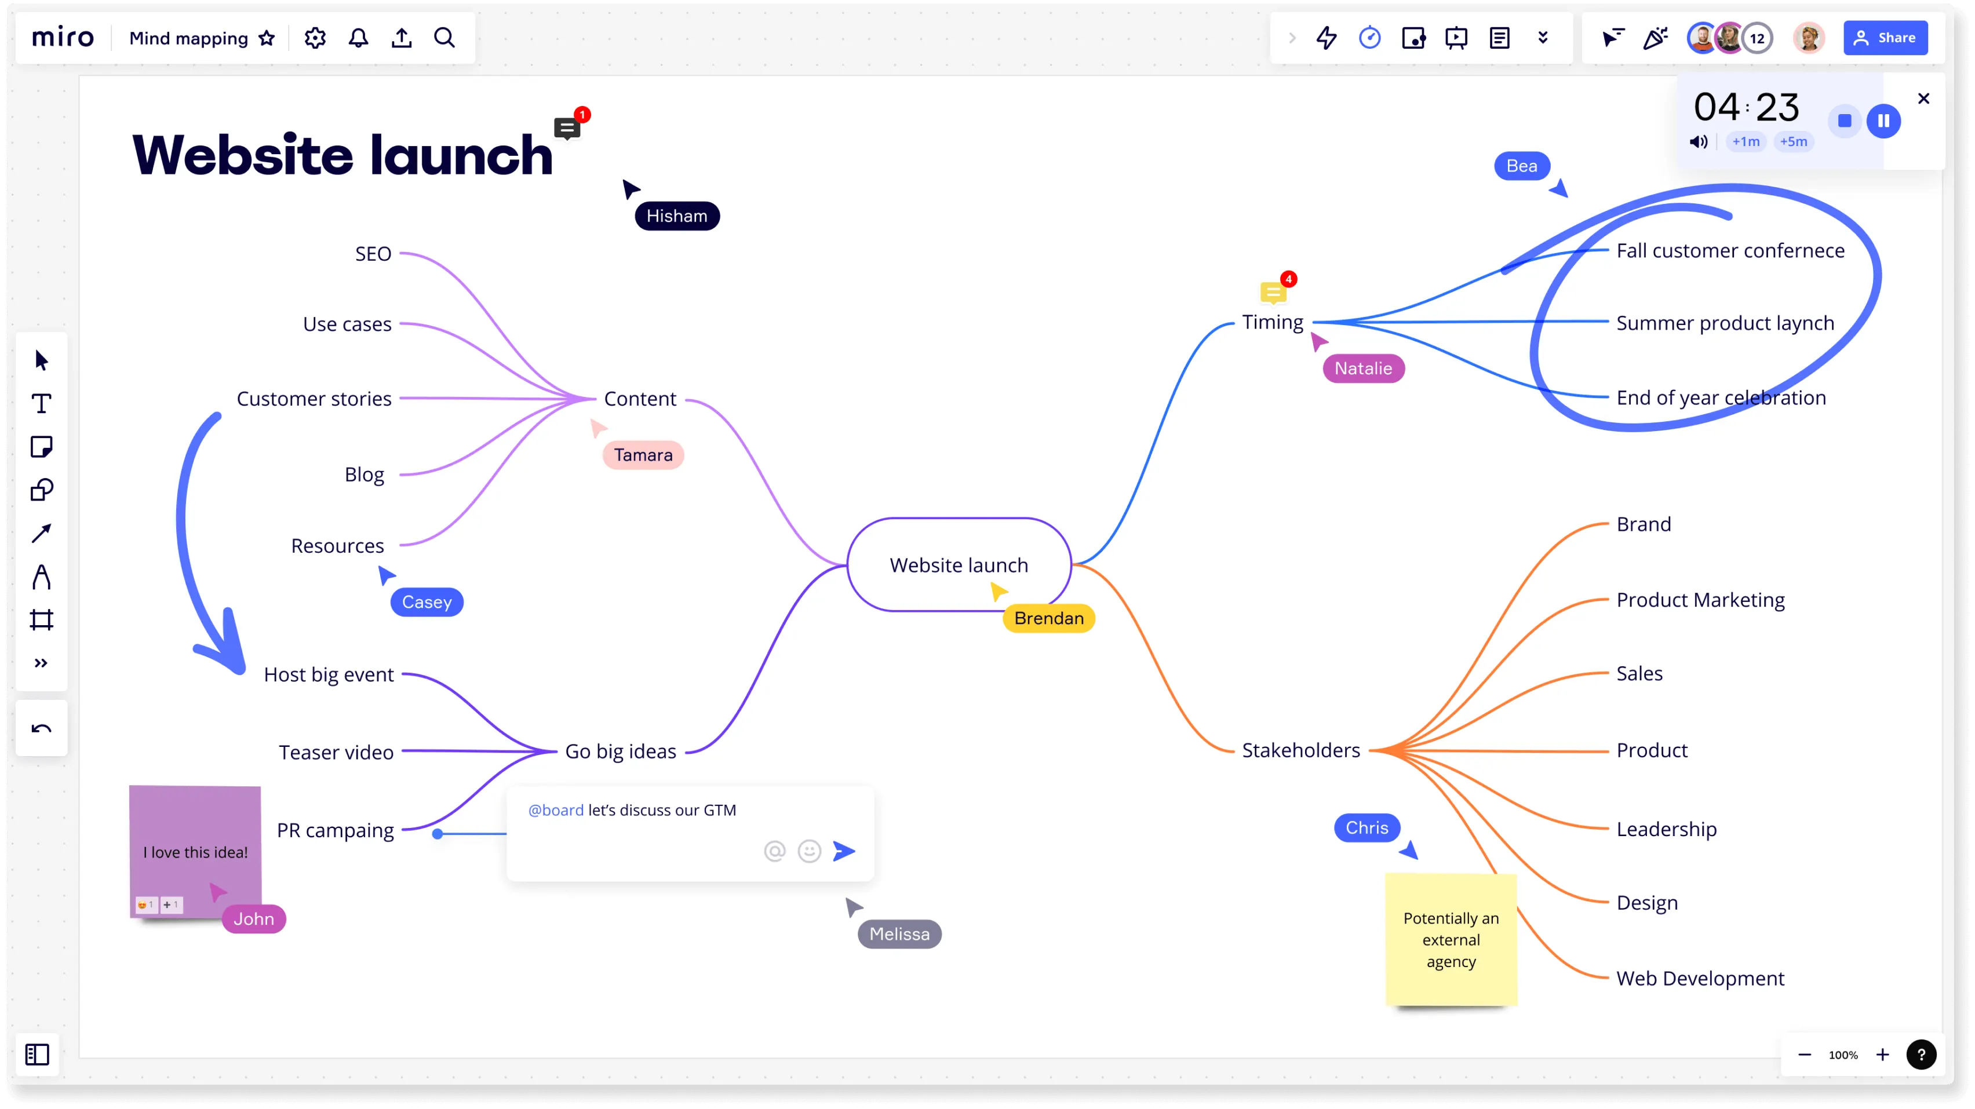
Which should lead to. . .
https://miro.com/mind-map/

Slide 73
Mind Maps. . .
are radiant, not linear
allow you to follow a train of thought and develop it later
are a literal map of our thoughts
mirror the way our brains work
use our visual-spatial system
have no right or wrong answer
Watch this - https://www.youtube.com/watch?v=5zT_2aBP6vM
Notes:
Allow you to develop an idea over time

Slide 74
https://miro.com/app/board/uXjVPtXX6-I=/
Notes:
https://miro.com/app/board/uXjVPtXX6-I=/

Slide 75

Notes:
https://miro.com/app/board/uXjVPtXX6-I=/

Slide 76
Follow along. . .
https://miro.com/app/board/uXjVPtXX6-I=/
Notes:
https://miro.com/app/board/uXjVPtXX6-I=/

Slide 77
What is a SWOT analysis?
A SWOT analysis is a planning tool which seeks to identify the Strengths, Weaknesses, Opportunities and Threats related to a subject. It's a framework for matching goals, requirements, actions and capacities to reality.
Source
Notes:
Reality – I want to be an ai developer -

Slide 78
SWOT Analysis
STRENGTHS
What do you do well?
What skills do you have?
What praise do you receive?
WEAKNESSES
What skills could you improve?
What resources do you lack?
What critique do you receive?
S
W
What opportunities do you have?
How can your strengths be used?
OPPORTUNITIES
What threats do you face?
What changes might be problematic
What do your weaknesses expose?
THREATS
O
T
Notes:
Can be used on any question.
In a game context

Slide 79
- Qualifications - Experience - Knowledge - Good Personal Attitude - Motivation - Skills / Qualities - Personal strengths (hobbies, interests)
- Gaps in qualifications - Gaps in your experience - Gaps in you knowledge - Personal (don’t like offices, grumpy in the morning) - Poor Time management
S
W
- Available job opportunities - Business opportunities - Learning opportunities - Available support - Gap in the market you can step into - New tools you can use
- Potential financial difficulties - Political decisions - Economic Conditions - Change in market skills need
O
T

Slide 80
Follow along. . .
https://miro.com/app/board/uXjVPtXX6-I=/
Notes:
https://miro.com/app/board/uXjVPtXX6-I=/

Slide 81
By the next session
Work on your mind map
Work on your SWOT analysis
Wrap up your retrospective
Start researching your ideas (and document the research)
Study Mind Maps
Study SWOT analysis

Slide 82
Follow along. . .
https://trello.com/b/hbU9rqx6/3014
Notes:
- Add submission dates

Slide 83

Thanks!
Any questions?
You can find me on Teams or via anthony.edwards@plymouth.ac.uk

